Slide 1
Ellicott City Flash Flood Tweet Analysis

Slide 2
Data Collection
140 tweets with images
Remove duplicates and stopwords
Nltk.corpus - stopwords
"ellicott", "city", "ellicottcity", "md", "maryland", "in", "elliott", "flash", "flood"

Slide 3
Method
LSA
Remove stop words
Vectorize with tf-idf weights
Num. of features = 120
K-means
Num. of clusters = 3
Num. of iterations = 5000

Slide 4
Results
LSA:
LSA variance: 94.25%
Time: 4.92sec
Tweet Distance:
Time: 3.42sec
k-means:
PCA variance: 24.39%
Time: 0.04sec

Slide 5
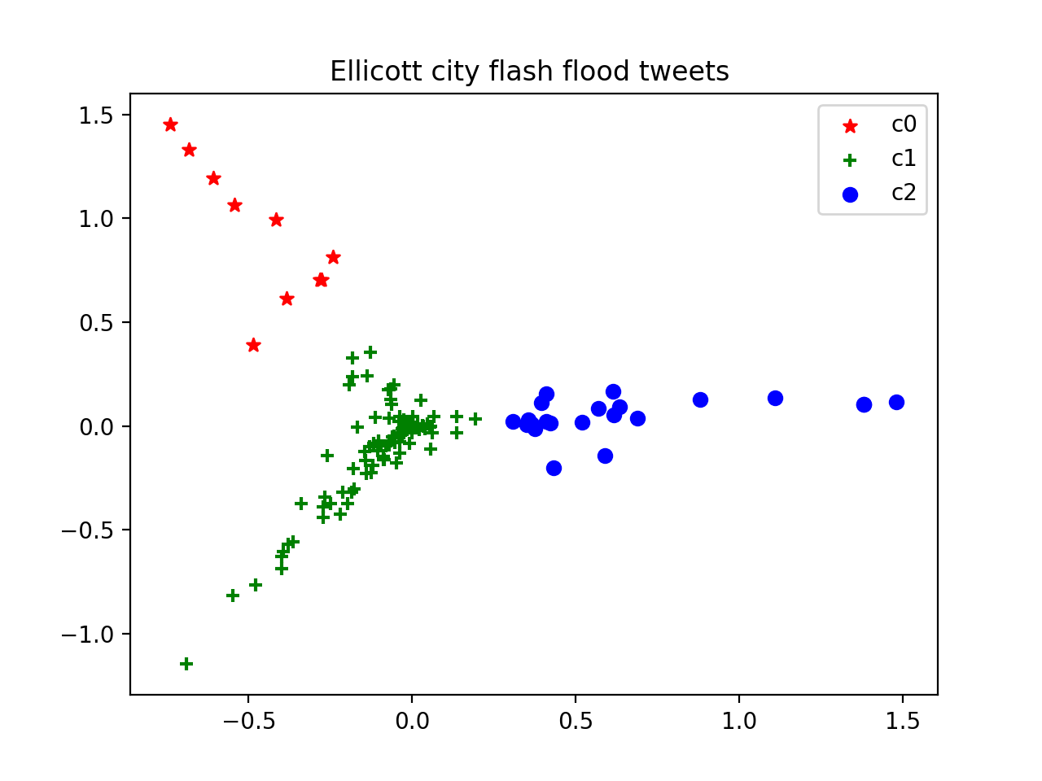
Clusters: PCA1 – PC2

Slide 6
Cluster0
at least 1 dead 2 missing after severe flash flood rips through ellicott city johnwoodrowcox ovettawashpost
severe flash flood in ellicott city kills at least 1 destroys businesses a vicious saturday night flash flo
devastating 1 dead others missing in ellicottcity after historic flood
i think
2 dead emergency declared after historic ellicott city ravaged by flash flood
video of tonights flood in historic ellicott city md scary and sad <3 i hope no one has been hurt or worse

Slide 7
Cluster1
ellicott city flash flood 7/30/2016 u2013 youtube
but ellicott city also in very flood prone area & has a long history of flooding not the best place for a town
priorities woman rescued in ellicott ellicott city from rising flood waters
flash flood kills 2 devastates maryland citys historic downtown jobs albania ellicott city md u2014 the
the power of water wow flashflooding ellicott city flash flood 7/30/2016
whats crazy is im looking at areas to move to and a friend suggested ellicott city after last nights floodthats gonna be a no for me

Slide 8
Cluster2
for nonlocals following flood damage in ellicottcity md our town dates back to 1772 site of worst damage is historic center of town
amazing the level of damage from the flash flood in elliott city md
a few more pics from flood damage in ellicottcity wbaltv 11 baltimore wbal wbaltv11
horrible scenes in the aftermath of the ellicottcity flash flood disaster
photos flooding ellicott city baltimore hit hard with flood damage
those rts of old ellicott city damage photos from last nights storm & flood brings tears to my eyes

